Slide 1

Pest Biology and Management Techniques in Grain Storage Facilites
Tom Phillips
Department of Entomology
Kansas State University, Manhattan, KS, USA

Slide 2
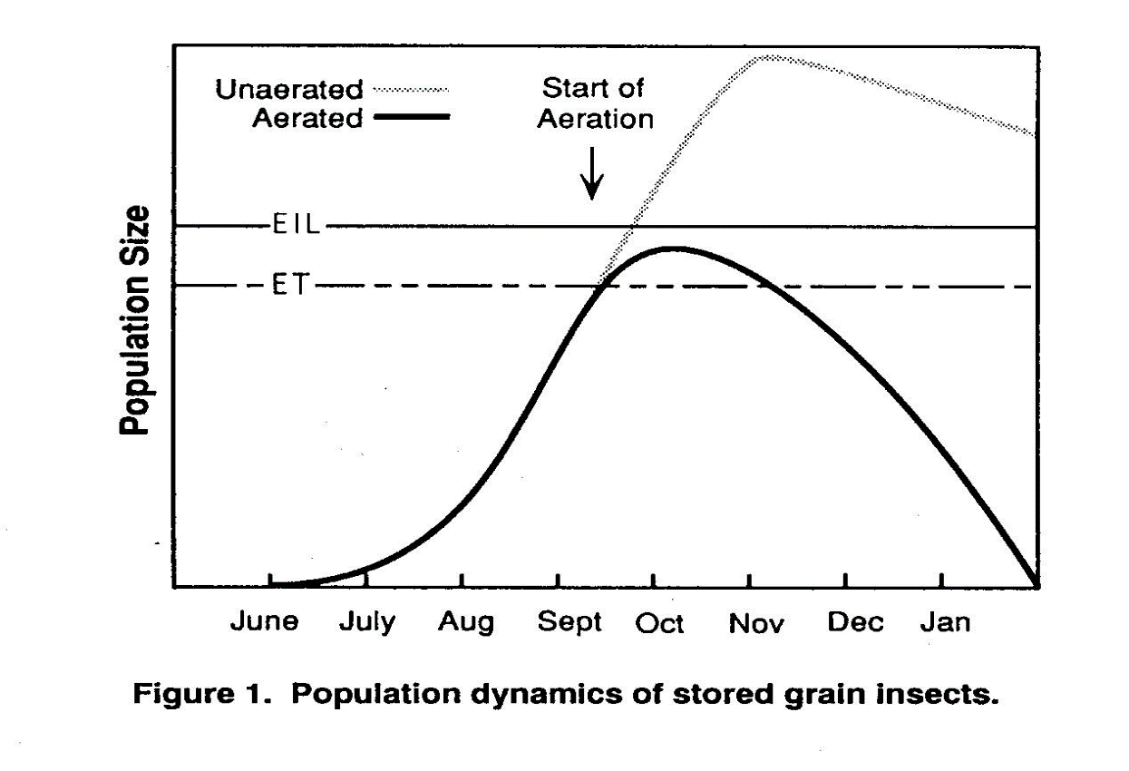
Economic Losses
Economic Injury Level
Non Economic
Losses
Economic Threshold
Pest and/or Injury Level
No Losses in value
Time Since Storage

Slide 3
Topics Covered Today
The stored product ecosystem
Pests and their biology
Integrated Pest Management
Current registered fumigants
Issues and challenges with current fumigants
Proper and improved fumigation
Potential “new” fumigants for registration
Non-chemical and low risk alternatives
Summary; questions, discussion

Slide 4
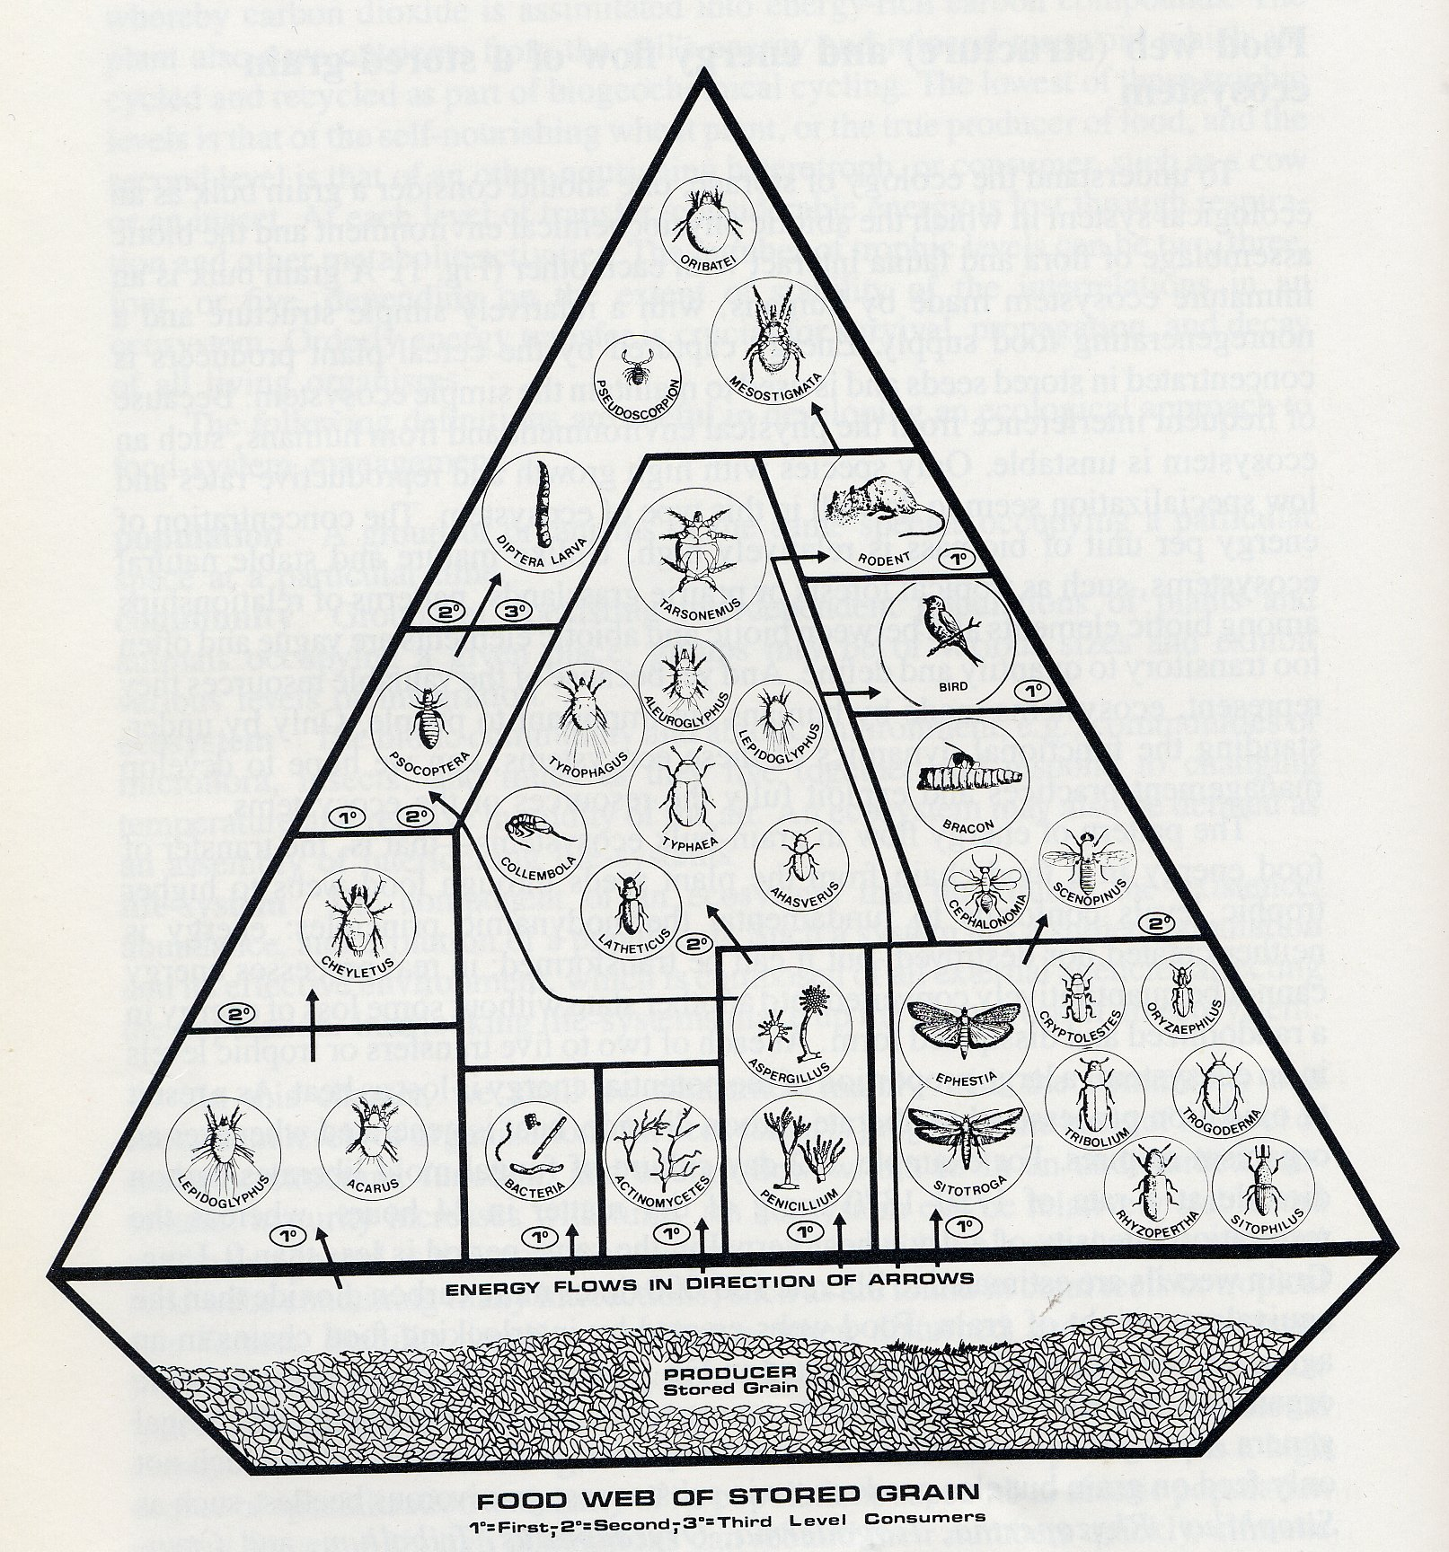
The Sored-Product Ecosystem

Slide 5
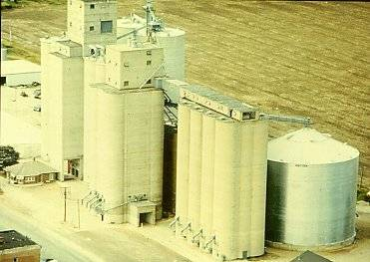
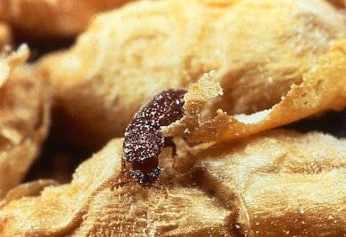
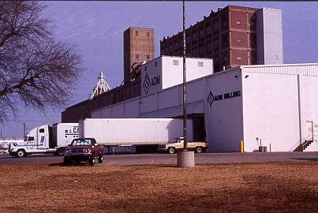
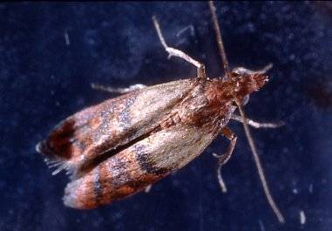

Slide 6
Internal Grain Feeders
Larvae develop inside whole kernels:
Less Grain Borer
Rice Weevil
Bean Weevil

Slide 7
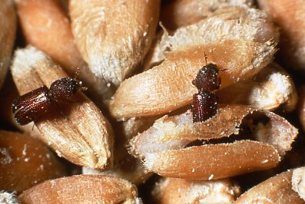
Lesser Grain Borer

Slide 8
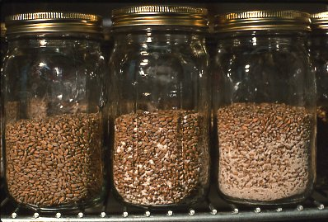
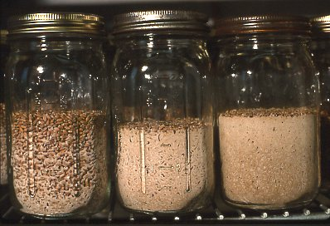
Lesser Grain Borer Damage
100 adults left in grain for 7 days and then removed
86º F
0 days 28 days 56 days 76 days 106 days 128 days

Slide 9
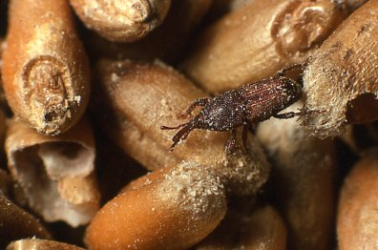
Rice Weevil

Slide 10
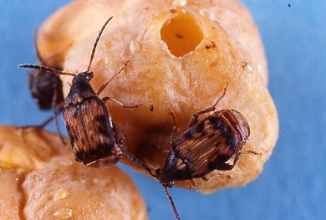
Cowpea Weevil, Bean Weevil

Slide 11
External Grain Feeders
Larvae develop on broken kernels, fine material, flour and fungi:
Red and Confused Flour Beetles
Sawtoothed and Merchant Grain Beetles
Rusty and Flat Grain Beetles
Cigarette and Drugstore Beetles
Foreign Grain Beetle
Hairy Fungus Beetle
Warehouse and Carpet beetle
Indianmeal Moth
Book Lice
Grain/Mold/Cheese Mites

Slide 12
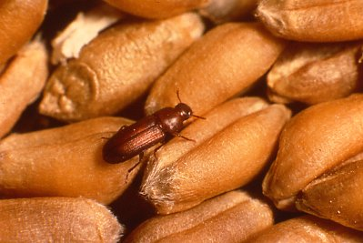
Red Flour Beetle

Slide 13
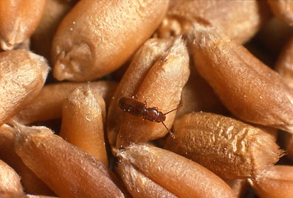
Rusty Grain Beetle

Slide 14
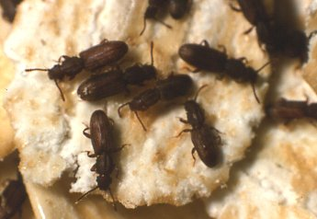
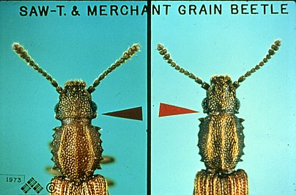
Sawtoothed Grain Beetle

Slide 15
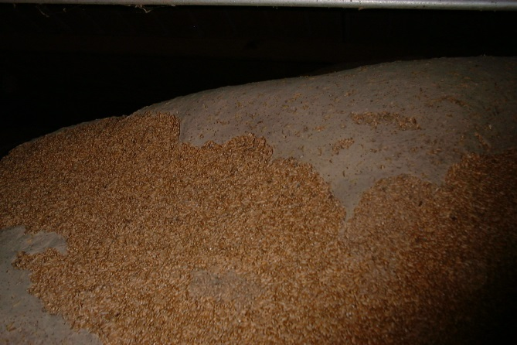
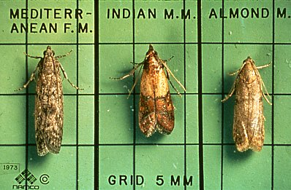
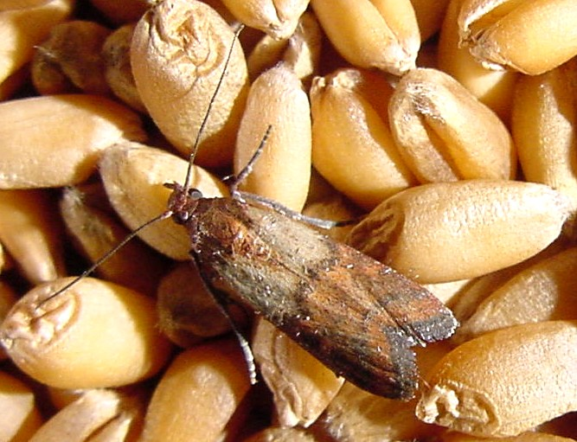
Indianmeal Moth
Three related moth species on grain, dried fruits and nuts
Larval Silk on Grain Mass
Indian Meal Moth on Wheat

Slide 16
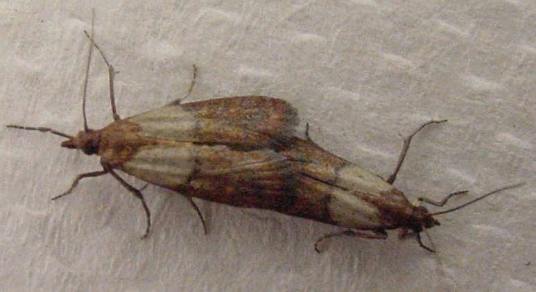
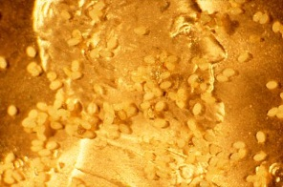
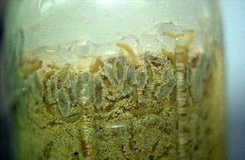
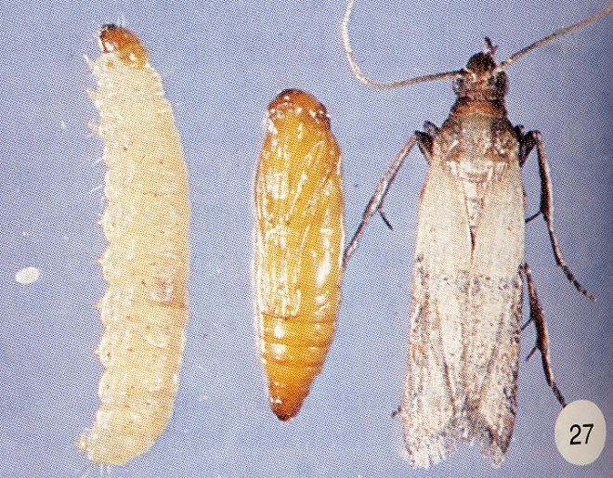
Indian Meal Moth
Adult Moths
Eggs
Larvae
Larva, Pupa, Adult

Slide 17
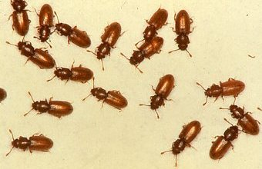
Foreign Grain Beetle

Slide 18
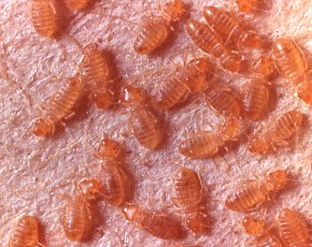
Book Lice

Slide 19
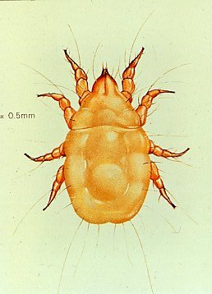
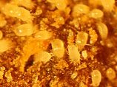
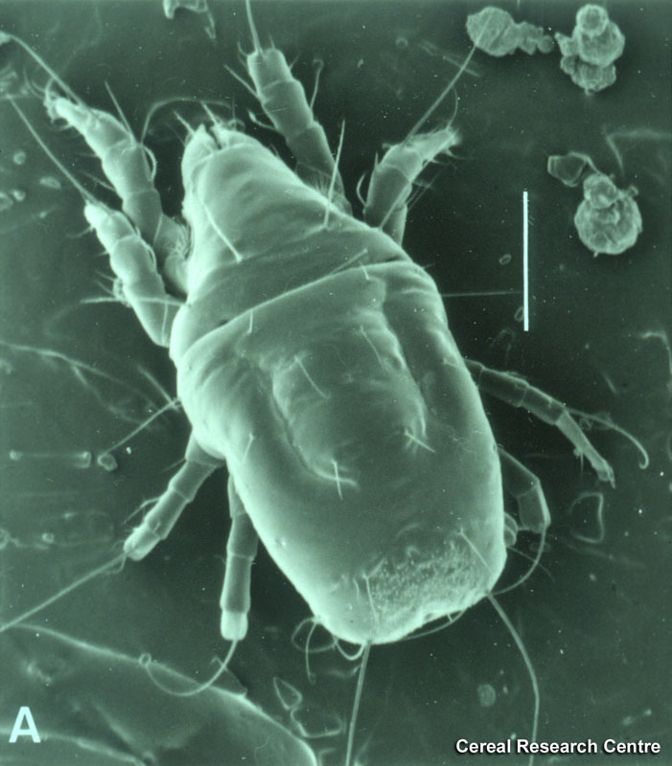
Grain Mite

Slide 20
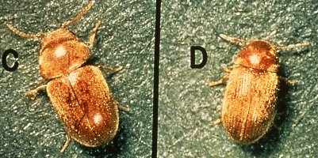
Cigarette Beetle Drugstore Beetle

Slide 21
Beneficial Insects for “Biological Control”
Insects that kill pest insects
Examples
Warehouse Pirate Bug
Parasitic Wasps

Slide 22
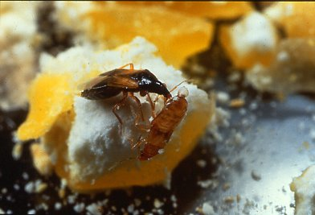
Warehouse Pirate Bug: A predator that kills many prey

Slide 23
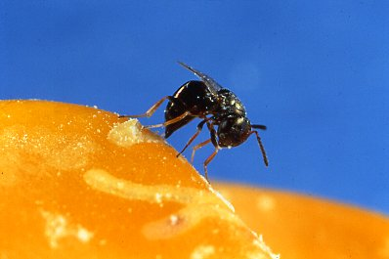
Parasitic Wasp: Lays egg on one host inside seed!

Slide 24
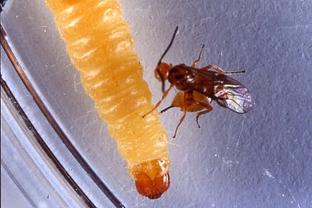
Parasitic Wasp Stinging Indianmeal Moth Larva

Slide 25
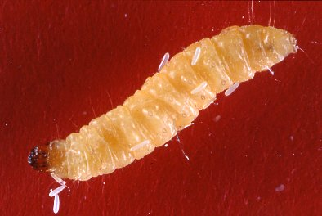
Wasp Eggs on Paralyzed Indianmeal Moth Larva

Slide 26
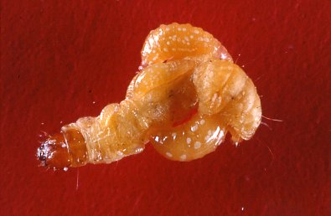
Wasp Larvae Consuming IMM Larva

Slide 27
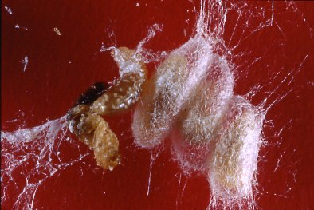
Pupal Cocoons of Parasitic Wasps on Spent Host

Slide 28
Factors Affecting Insect Population Growth
Food – availability and quality-both high in stored grain
Habitat-stored grain is “safe”, good temperature, etc.
Temperature-never too hot or too cold
Relative humidity-insect do well when high
Moisture content of food or grain-best at 12-15% water

Slide 29
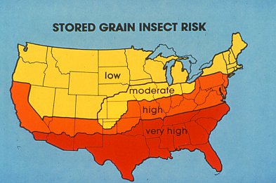

Slide 30
Integrated Pest Management (IPM) for Stored Products
Prevention/Sanitation
  Store insect-free grain; repair bins
  Clean empty bins to remove residual insects
Monitor grain temperature and quality
Sample grain for insects
Use all information to make decision
Continue storing, or…take action!

Slide 31
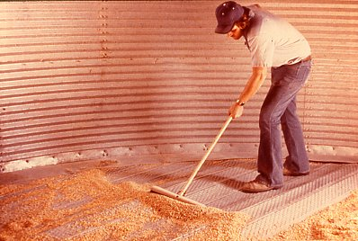
Sanitation

Slide 32
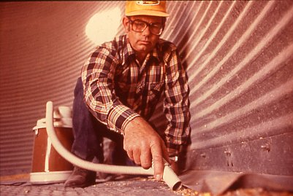

Slide 33
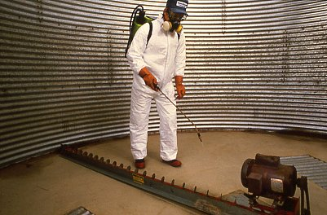
No confined space applications
All applications from outside top hatch

Slide 34
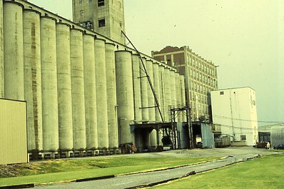
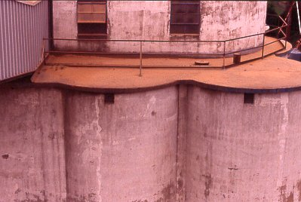
Many older structures persist, but need to be replaced (unlikely), repaired and sealed
No aeration
Difficult to clean
Leaky

Slide 35
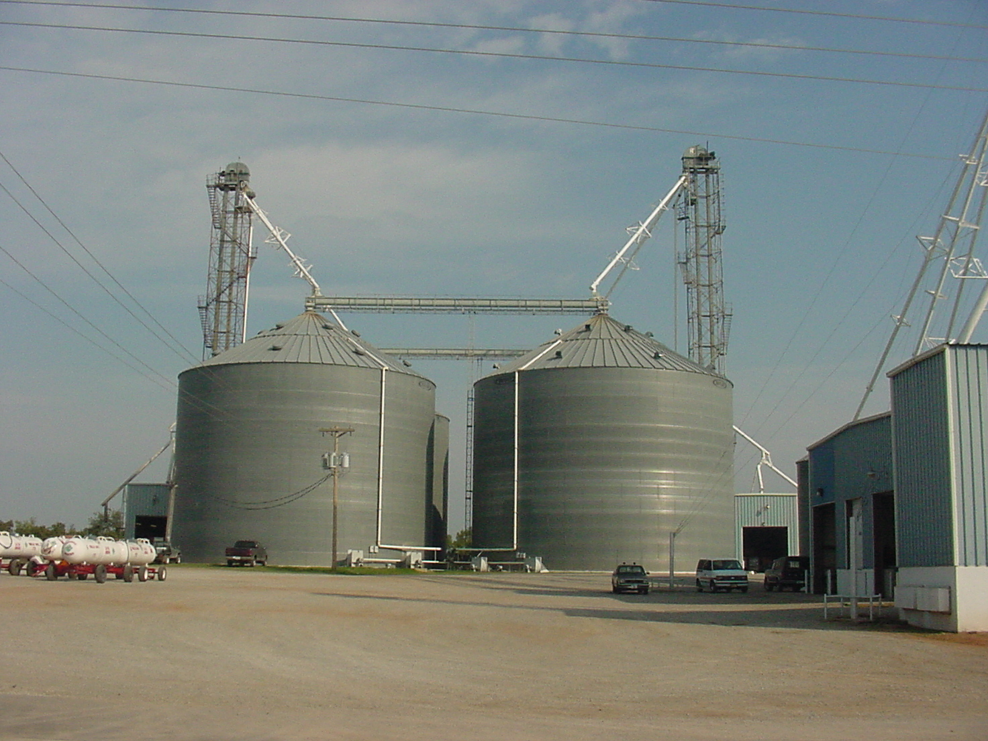
Improved Structures to Exclude Pests
Well-sealed storages
Good access for cleaning and repair
Computer-controlled temperature monitoring and aeration
Fumigant recirculation system in place

Slide 36
Monitoring Insects
Insect sampling
Trapping insects
Detection and monitoring in food plants

Slide 37
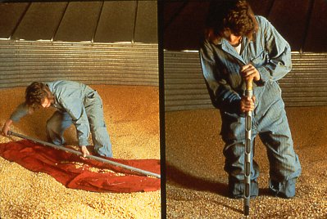
Manuel sampling gives limited information

Slide 38
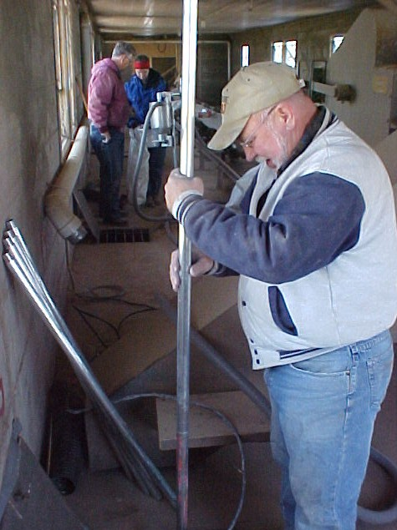
Vacuum sampling gives more information

Slide 39
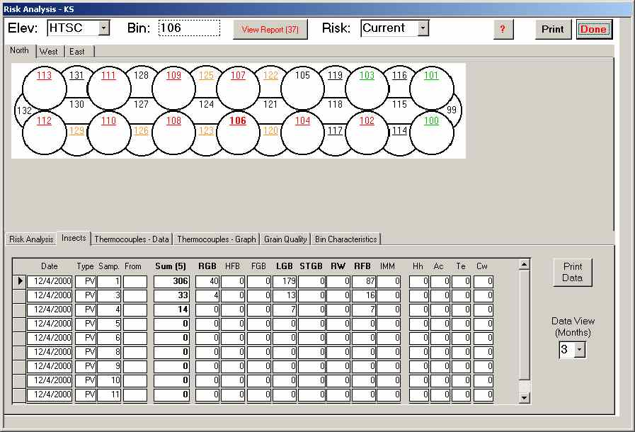
Visualization of Insect Sample Data

Slide 40
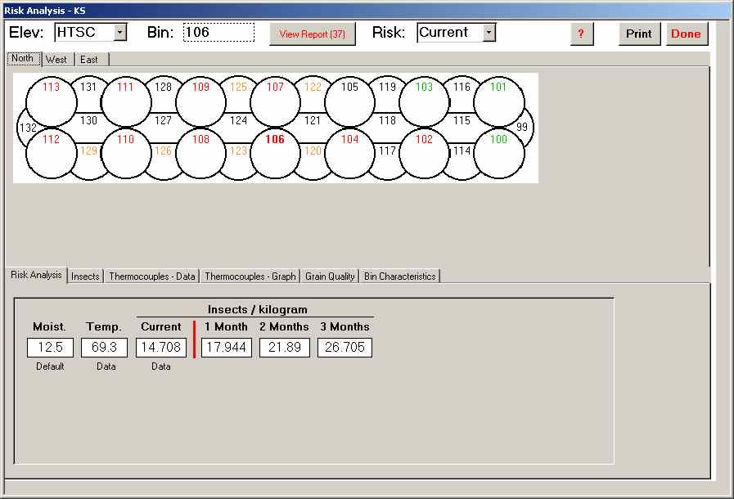
Software Provides Risk Predictions

Slide 41
Monitoring in Flour Mills, Food Plants and Finished FoodWarehouses
Can not easily sample product for insects
Pheromone traps are sensitive detection tools
Pheromones known for > 40 species
Lures available for 20 species; a few predominate
  Indianmeal moth and other related moths
  Cigarette beetle
  Tribolium flour beetles
  Warehouse beetle and other related beetles
Trapping programs can detect spatial and seasonal variation in numbers; allow for control decisions

Slide 42
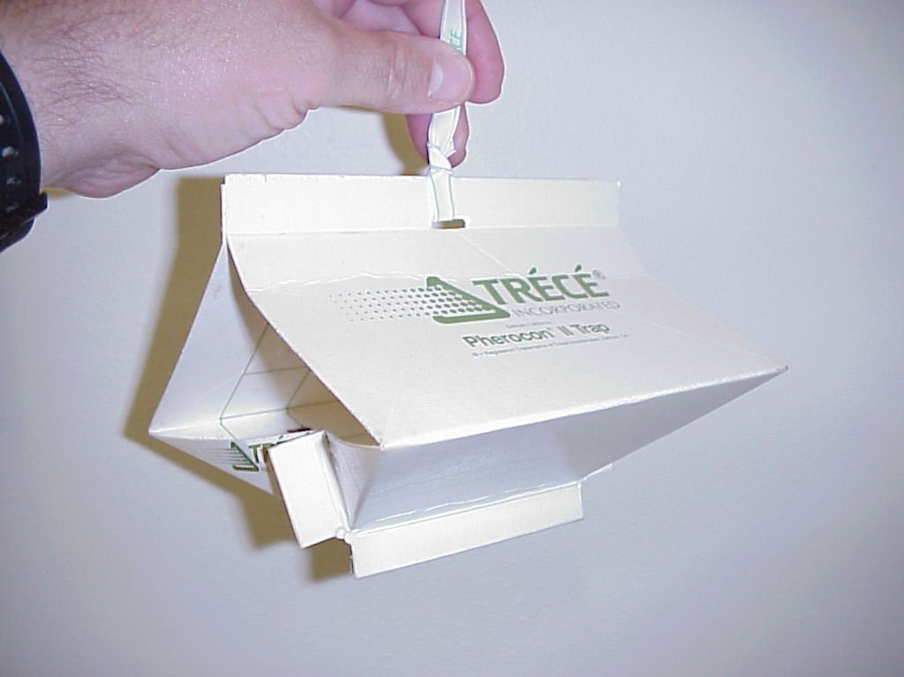

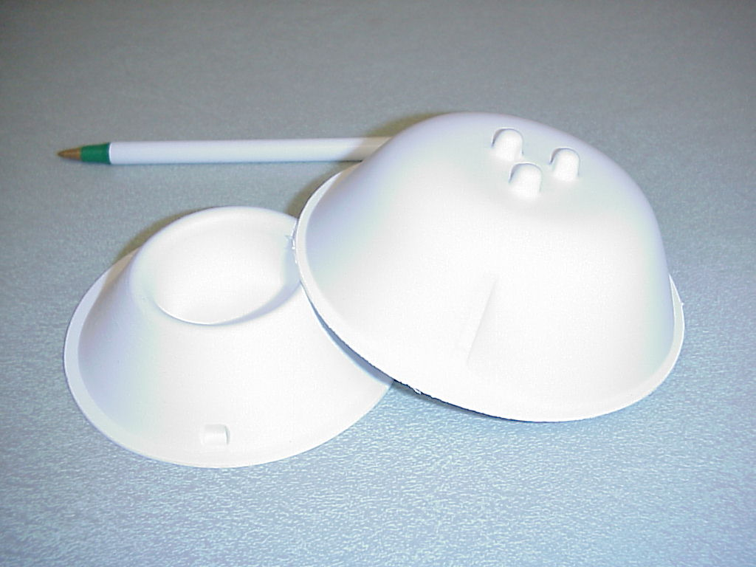
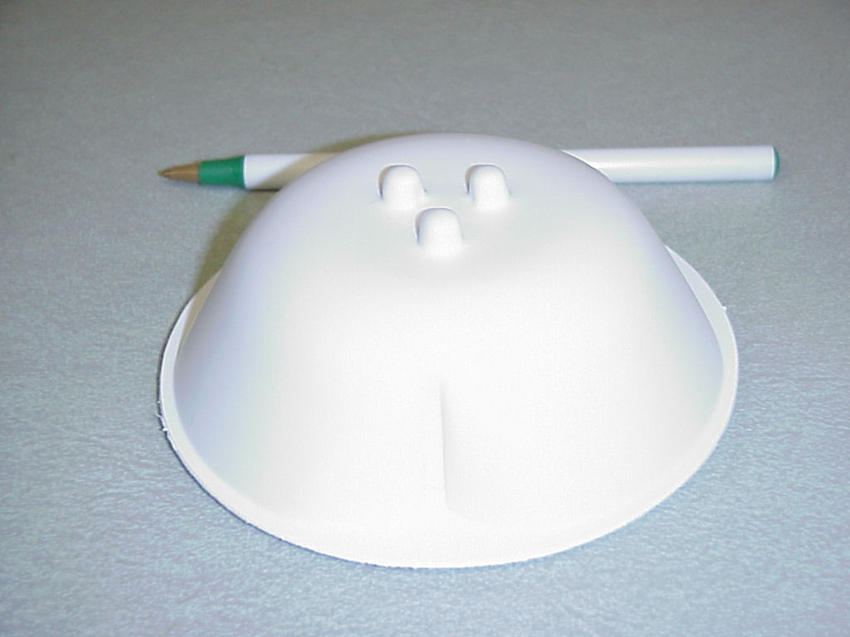
Pheromone Traps

Slide 43
Spatial Analysis of Trap Captures
Beetles
Moths

Slide 44
Registered Structural Fumigants in the US
Methyl Bromide
Phosphine
Sulfuryl Fluoride
Carbon Dioxide

Slide 45
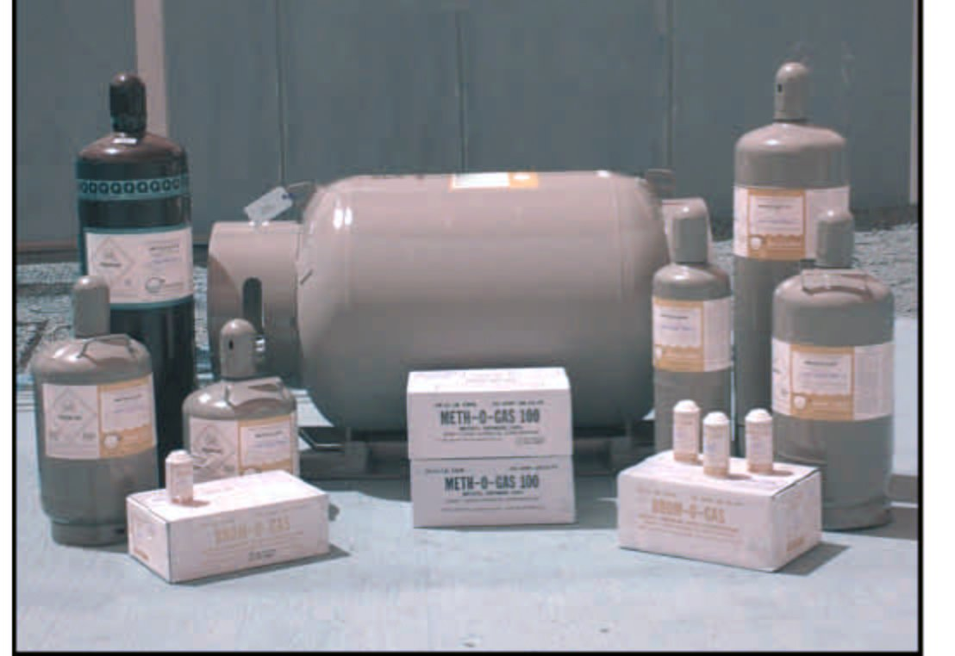
Methyl Bromide: Being Banned Worldwide

Slide 46
Ban of Methyl Bromide under Montreal Protocol
The US, Canada and Australia are the only three countries among all 200 signatories to have Critical Use Exemptions, CUEs
US has four groups with CUEs approved for 2014 and CUNs (nominations) for 2015
  Postharvest commodities
  Strawberries
  Other structures (National Pest Management Association)
  Southern dry cured hams
After January 2015, likely that only QPS, Quarantine and Pre-Shipment, uses will remain, and these are threatened

Slide 47
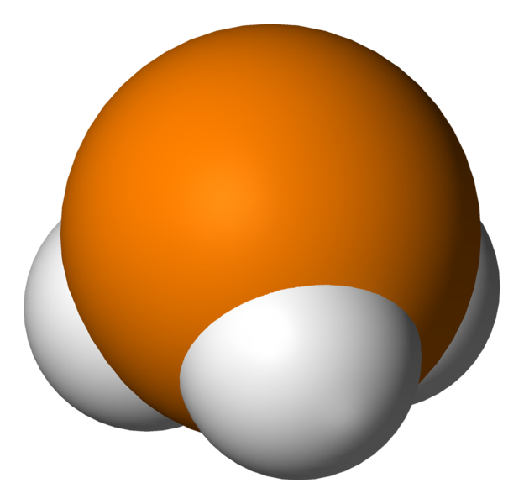


Phosphine-Cheap- Easy to Apply, Effective….Usually
Light weight; penetrates well
Phosphide salts cheap and easy
Cylinder gas is quick
Effective for most pests
Corrosive to electrical fixtures
Resistance present and spreading

Slide 48


Sulfuryl Fluoride
Non-corrosive; non-ozone depleter
Easy to apply from cylinders
Difficult to kill eggs and some pests
Low fluoride ion residues
Revocation of food tolerances considered
Implicated as weak greenhouse gas
Possibly alternative for MB and Phosphine

Slide 49
Current Issues and Challenges for Fumigation
Methyl Bromide alternative adoption
Phosphine resistance in grain insects
Sulfuryl Fluoride effectiveness
Alternative fumigants
Residual chemicals in stored products
Biological and physical control alternatives
Summary

Slide 50
The Problem with Methyl Bromide-MB
MB will be gone for domestic use after 2015
MB for QPS (quarantine and pre-shipment) will probably stop
Current alternatives all have challenges, but can be applied and effective
Commodity and food managers will need to adjust their culture to work without MB
Current alternatives in mills/processing: ProFume, Heat Treatments, better IPM + residual sprays/aerosols

Slide 51



Phosphine: from Metallic Phosphide Salts
Aluminum Phosphide and Magnesium Phosphide both with water in the air to produce Hydrogen Phosphide
AlP + 3H₂O → Al(OH)₃ + PH₃
Mg₃P₂ + 6H₂O → 3Mg(OH) ₂ + 2PH₃

Slide 52




Laboratory Fumigation Bioassays

Slide 53




Fumigation Bioassays-Quantitative Gas Chromatography

Slide 54

Resistance to Phosphine?

Slide 55

PH3 Resistance Study of OK Grain Pests
G. P. OPIT, T. W. PHILLIPS, M. J. AIKINS, AND M. M. HASAN. 2012. Phosphine Resistance in
Tribolium castaneum and Rhyzopertha dominica From Stored Wheat in Oklahoma. 105: 1107-1114.

Slide 56
Phosphine Resistance in LGB
10 Adults per vial; 20 ppm gas for 20 hours
Sample | % mortality
 | Replicate 1 | Replicate 2
Payne 1 | 2 | 18
Payne 2 | 88 | 62
Payne 3 | 66 | 86
Garfield | 2 | 4
Logan | 10 | 2
Susceptible | 100 | 100

Slide 57

%Kill from Increasing Doses
Statistics can Predict Dose Needed

Slide 58
Estimates of Doses to Kill Phosphine Susceptible and Resistant LGBs
Sample | LC₅₀ (95% CI) | LC₉₅ (95% CI) | LC₉₉ (95% CI) | Χ² (df) [H*]
Susceptible | 0.65 (0.60 – 0.71) | 1.45 (1.28 – 1.70) | 2.26 (1.70 – 2.90) | 4.1 (10) [0.4]
Payne 1 | 288.17 (260.36 – 311.39) | 447.52 (400.17 – 548.55) | 572.78 (485.32 – 790.58) | 46.9 (19) [2.5]
Logan | 62.24 (39.99 – 91.44) | 591.71 (360.07 – 1377.69) | 2054.40 (972.25 – 8002.30) | 106.8 (19) [5.6]
Garfield | 104.90 (44.97 – 167.69) | 980.18 (556.39 – 3233.41) | 3430.80 (1426.70 – 27142.0) | 138.7 (19) [7.3]

Slide 59
Comparison of Lethal Concentrations Required to Kill 50, 95, and 99% of LGB Populations
Samples compared | # of concentration groups | Lethal concentration ratios
 |  | LC₅₀ (95% CI) | LC₉₅ (95% CI) | LC₉₉ (95% CI)
Payne 1 vs Susceptible | 33 | 442.80 (401.34 – 488.53) | 309.80 (262.46 – 365.69) | 253.59 (198.85 – 323.39)
Logan vs Susceptible | 33 | 98.72 (82.62 – 117.95) | 409.62 (307.77 – 545.18) | 909.57 (587.46 – 1408.28)
Garfield vs Susceptible | 33 | 161.19 (129.58 – 200.52) | 678.55 (503.47 – 914.51) | 1518.91 (943.28 – 2445.79)
Logan vs Payne 1 | 42 | 0.22 (0.19 – 0.26) | 1.32 (1.02 – 1.72) | 3.59 (2.38 – 5.40)
Garfield vs Payne 1 | 42 | 0.36 (0.30 – 0.45) | 2.19 (1.66 – 2.89) | 5.99 (3.82 – 9.40)
Garfield vs Logan | 42 | 1.63 (1.27 – 2.11) | 1.66 (1.15 – 2.38) | 1.67 (0.94 – 2.98)

Slide 60
Managing Phosphine Resistance
Stop using phosphine for one or more seasons
Susceptible genes will build up, and formerly resistant populations will be killed
Use a totally different fumigant! New mode of action; must kill all PH3-resistant pests!
Practice good stored grain IPM: prevention, monitoring, targeted action

Slide 61

ProFume = Sulfuryl Fluoride (Vikane)

Slide 62




The Ham Mite, Tryophagus putrescentiae

Slide 63
Mortality of Ham Mites under SF

Slide 64
Summary of Ham Mite Mortality under SF
**LC-95 for mite eggs is nearly 3 X the maximum EPA label rate!!!

Slide 65
Mortality of Ham Mites under PH₃ in 48 Hrs
Notes:
For PH3, 1g/m3 = 714.81 ppm
0.85 g/m3 = 608 ppm

Slide 66



Corrosion of Copper a Problem with Phosphine
Control-no PH3
Very bad for all electrical circuits, machines, wiring and computers!!!
1500 ppm
Control vs. 700ppm

Slide 67




Fumigants with Potential for Registration on SPs
Ethyl Formate: food safe
Propylene Oxide: registered antimicrobial
MITC from Metam Sodium: registered soil fumigant
EF
PPO
Metam Sodium
MITC, Methyl Isothiocyanate

Slide 68
Normal Atmosphere can be Changed!
Nitrogen, N₂ = 78.0%
Oxygen, O₂ = 20.9%
Carbon Dioxide, CO₂ = 0.03%
Sea Level Pressure = 760 mm Hg
Controlled Atmosphere Treatments:
  Increase CO₂ as a toxin
  Reduce Oxygen to suffocate pests

Slide 69

Carbon Dioxide
High doses, needs good sealing and long exposures
Can be very expensive
Greenhouse gas that may require re-capture
Sometimes best for chamber fumigations, when other chemicals are not advised

Slide 70



Example: Mortality of Ham Beetles Under CO₂
60% CO₂ was needed to kill 100% ham beetle eggs and adults at 144h--Expensive

Slide 71


Pressure Reduced to 25 mm Mercury in Flask by Vacuum Pump for 1% Oxygen

Slide 72
Mortality of Ham Beetles Treated at Low Oxygen under Low Pressure at 23°C

Slide 73
Reduced Risk Chemicals and Alternatives as Grain Protectants
Diatomaceous Earth
Spinosad
Insect Growth Regulators

Slide 74


Diatoms-Skeletons of Algae Mined from Ground:
absorb waxes from insect cuticle; insects desiccate

Slide 75


Slide 76


Slide 77
Biological Insecticide: Spinosad
A reduced-risk pesticide – low mammalian and avian toxicity
Derived from a bacterial fermentation product
Broad-spectrum – toxic by ingestion and contact
Extremely effective against lesser grain borer
Registered in U.S. at 1.0 ppm
Product name is Sensat® from Bayer Crop Sciences
Should be approved for Organic Foods

Slide 78

Small Bin Trial of Spinosad at Oklahoma State University
Replicated bin study
Spinosad alone at 1 ppm
Reldan alone at 6 ppm
Untreated bins
Grain stored 2 years with no other treatments

Slide 79
Average No. of Insect-Damaged Kernels, IDK, per 100g Sample after Two Years
Untreated 130
Reldan 942
Spinosad 2

Slide 80
What is an IGR?
IGR=Insect Growth Regulator
Chemical mimic of insect growth or molting hormone
Does not kill adults or larvae directly
Insect dies when molting is disrupted
Extremely non-toxic and arthropod specific
Gentrol (Hydroprene) and Archer (Pyroproxyfen) registered for food processing; Methoprene for stored grain

Slide 81

Effects of IGRs-20 beetle treated as larvae
Developed on Untreated Surface
Developed on Treated Surface

Slide 82
Summary and Conclusions
Stored-product insects continue to be important pests in stored grain, food processing and elsewhere
MB will be gone for domestic US after 2015
Phosphine can be an alternative; BUT resistance is spreading and corrosion is a problem
ProFume is an alternative, but adequate exposure and temperature needed to kill eggs
Commodity and food managers will need to adjust their culture to work without MB, try various alternative and adopt an IPM program

Slide 83
Acknowledgements
Numerous students and collaborators
USDA-Methyl Bromide Transition Program
Kansas Agricultural Experiment Station
Various donors/collaborators from pesticide industry
Thank you!
twp1@ksu.edu

